Slide 2
Digital System Design Group 7 – Hole In the Wall
Gustavo Maia Ferreira
Heyang Wang
João Marcus Ramos Bacalhau
07/04/2015

Slide 3
Overview
Introduction of the game
Image Processing
Hardware Architecture
Custom IP
Software
Design Flow

Slide 4
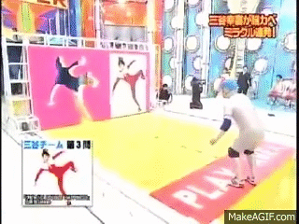
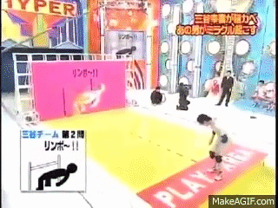
Introduction
A game derived from a Japanese TV show.
Initial goal: to reproduce the game using image processing.
Developed using the Digilent Nexys 4 DDR board.

Slide 5

Requirements
Give the impression that the wall moves towards the player.
Scale the wall.
The wall should not overlay the player during the game.
Merge video and wall.
Be able to segment the player from the background.
Implement image filtering using colour threshold.

Slide 6



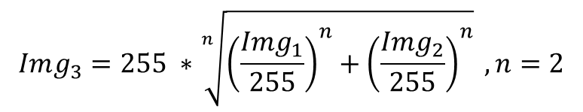
Image Processing
$$Img_{3}=255 ∗\sqrt[n]{{\left(\frac{Img_{1}}{255}\right)}^{n}+{\left(\frac{Img_{2}}{255}\right)}^{n}} , n=2$$
CEMENT

Slide 7




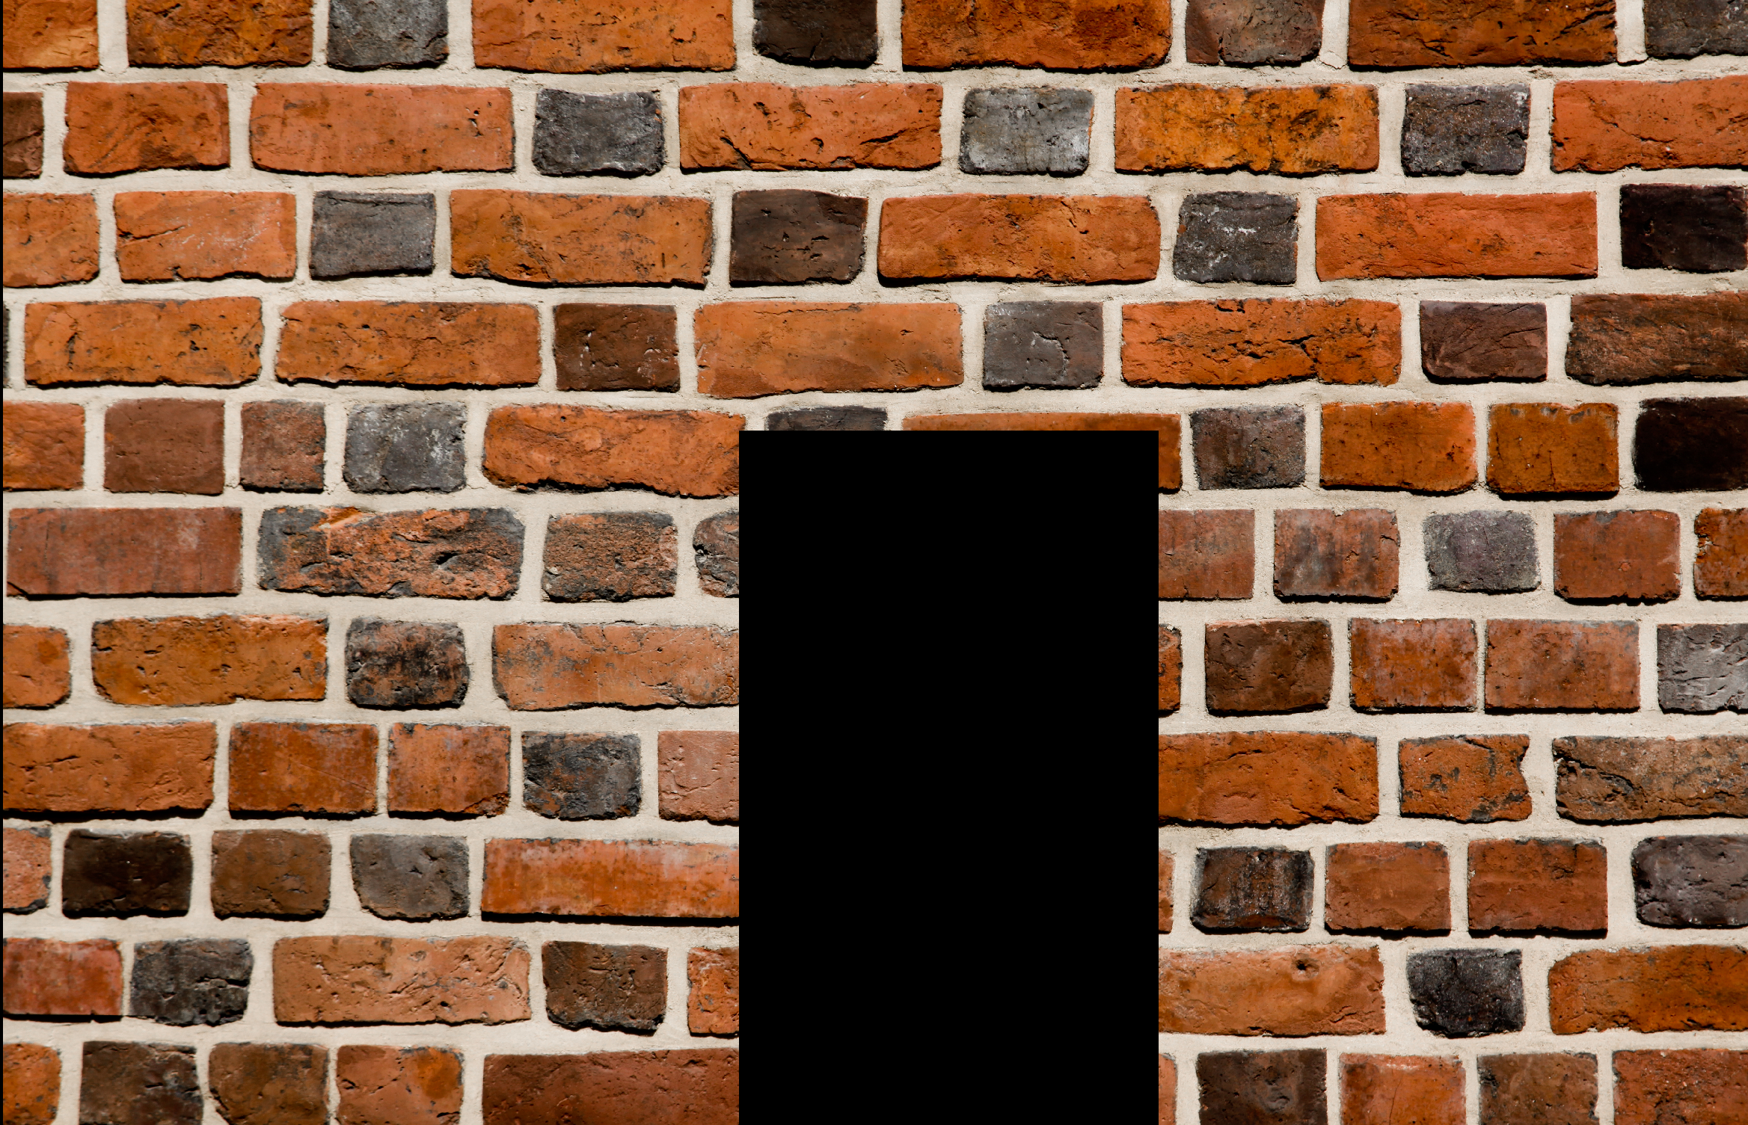
Image Processing
Colour Threshold

Slide 8
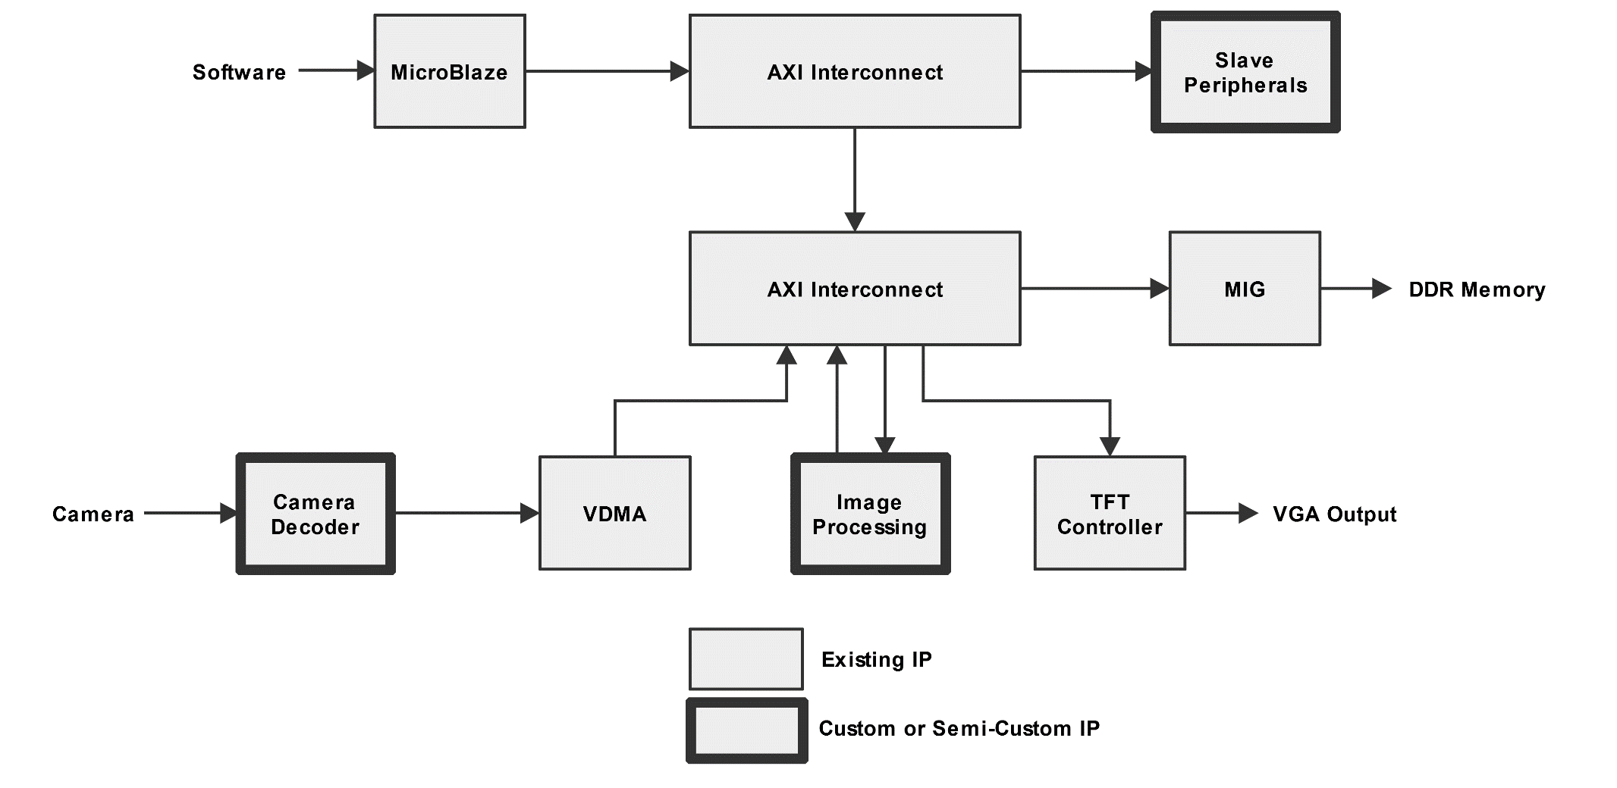
Architecture

Slide 9
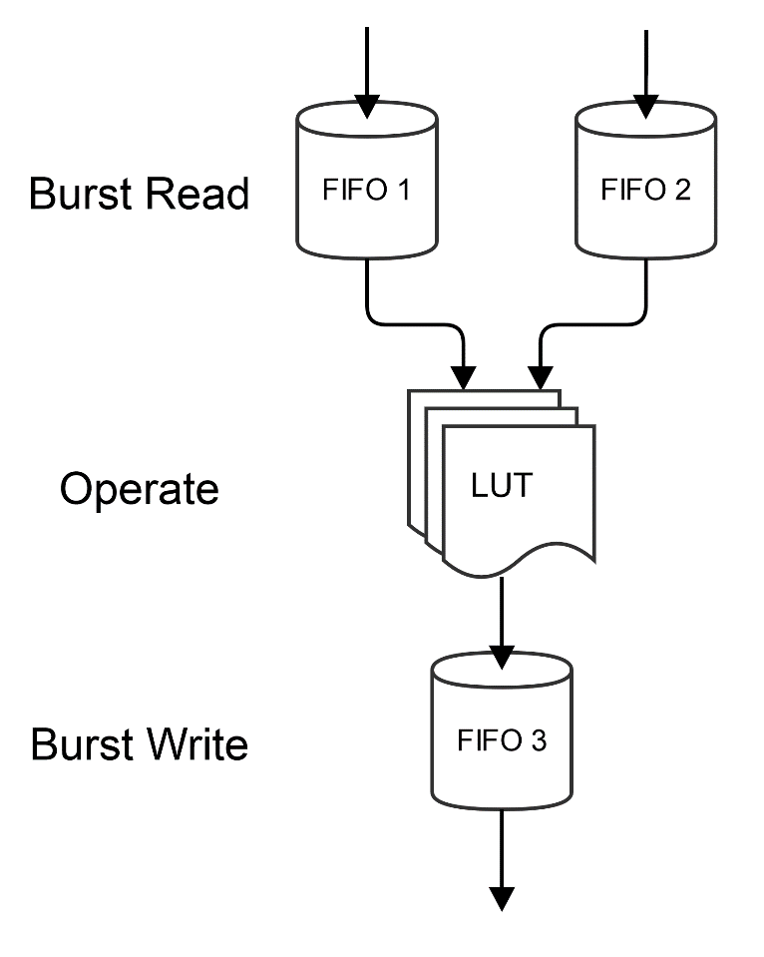
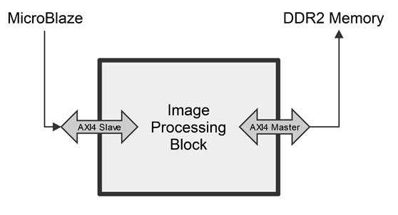
Custom Image Processing Block

Slide 10
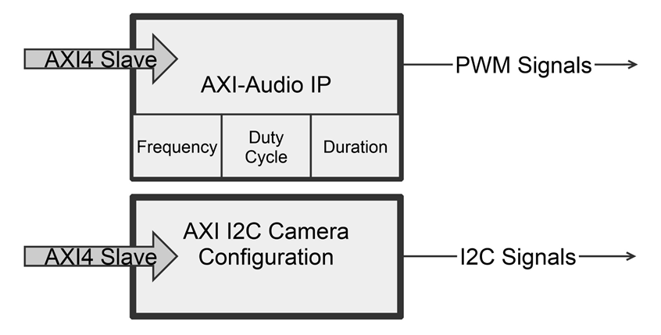
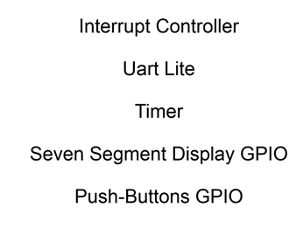
AXI Slaves

Slide 11
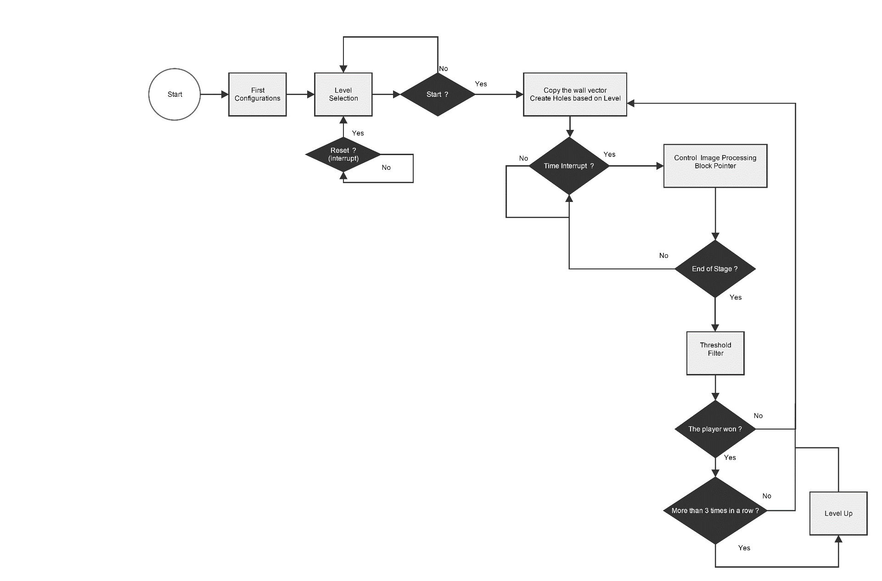
Software Block Diagram
Libraries + Main program: (2500 lines!!)
#include "create_wall.h”
#include "audioip.h
#include "cameraConfig.h”
#include "vdmaConfig.h"
#include "ImgProc_config.h"

Slide 12
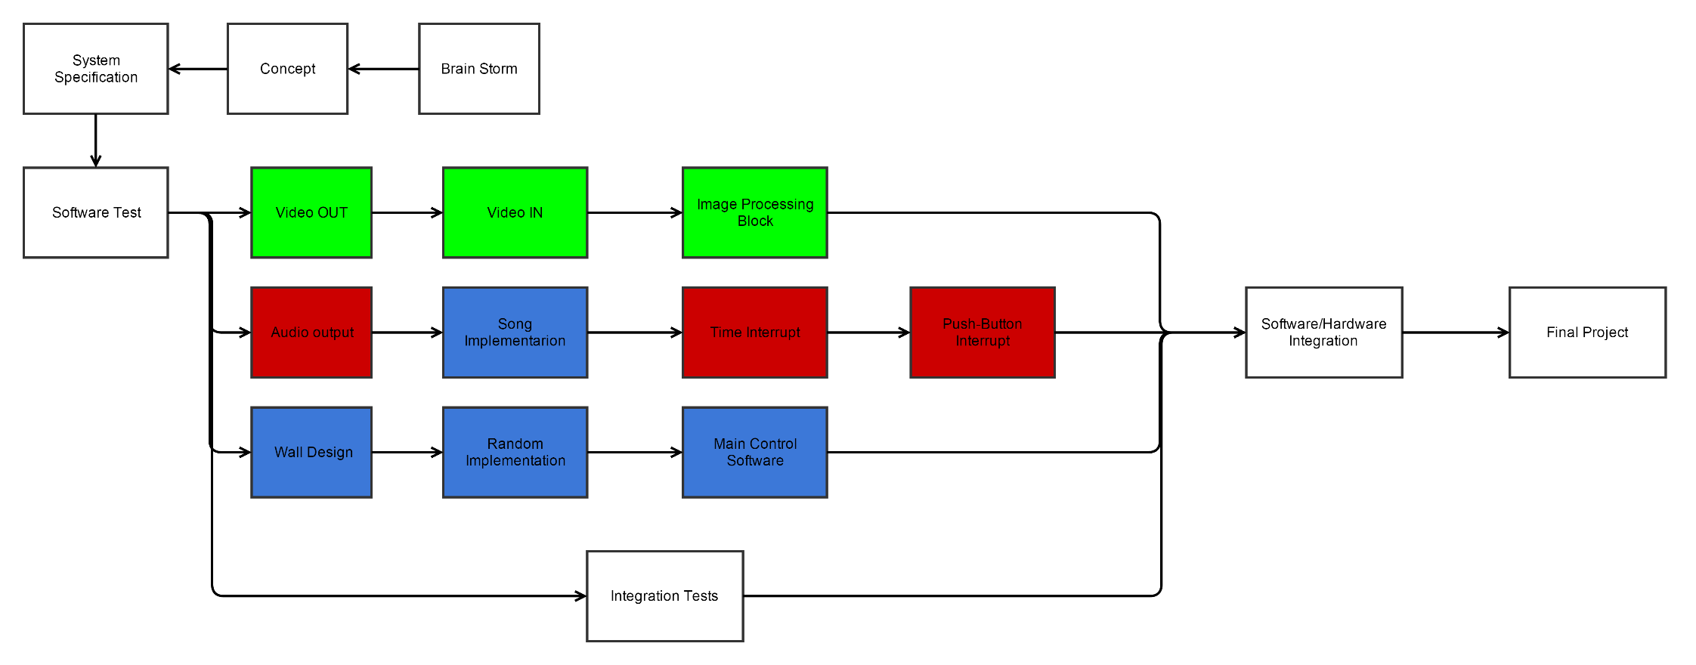
Design flow

Slide 13
DEMO

